Slide 1
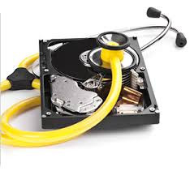
Volume Analysis
-- Srinivas Garapati

Slide 2
Overview
Introduction
Volume and Partition concepts
Usage of volumes in Windows and Unix
Volume Assembly
Sector Addressing
Analysis Techniques and consistency checks
Extracting the Partition Contents
Recovering Deleted Partitions
Summary

Slide 3
Introduction
Volumes are used to store file system and other structured data
Digital investigation involves acquiring disk image.
Notes:
Digital storage media is organized to allow efficient retrieval of data
Many digital investigation tools automatically break the disk image into partitions, but sometimes they have problems

Slide 4
Volume Concepts
A volume is a collection of addressable sectors that an Operating System (OS) or application can use for data storage.
Two Central concepts:
Assembling multiple storages
Partitioning storage volumes
A hard disk is an example of volume that has consecutive sector locations
Notes:
Volume sectors need not be consecutive on storage device just need to seem like that
A volume can also be a result of merging and assembling of smaller volumes
Parition and volume used together but different.

Slide 5
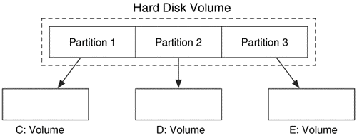
General Theory of Partitions
A collection of consecutive sectors.
Different operating systems use different partitioning methods.
Notes:
Partition is also a volume
Each partition may have a different file system eg:FAT NTFS EXT2
Windows assigns names to each volume
Partions methods will be discussed in chapter 5

Slide 6
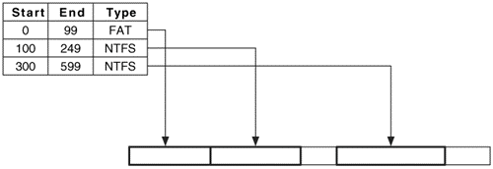
Partition table
In general partition systems may have one or more tables.
Notes:
Each entry is a partition
Entries cannot serve its purpose until start and end values are correct.

Slide 7
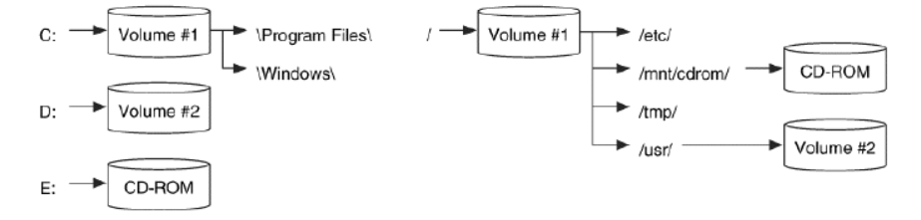
Usage of volumes in Windows vs Unix
Windows : uses drives for volumes
Unix : series of directories
Notes:
In windows we have drives in unix it has series of directories
Unix main directory is root
Unix to minimize corruption and to increase efficiency divides partions into separate volumes

Slide 8
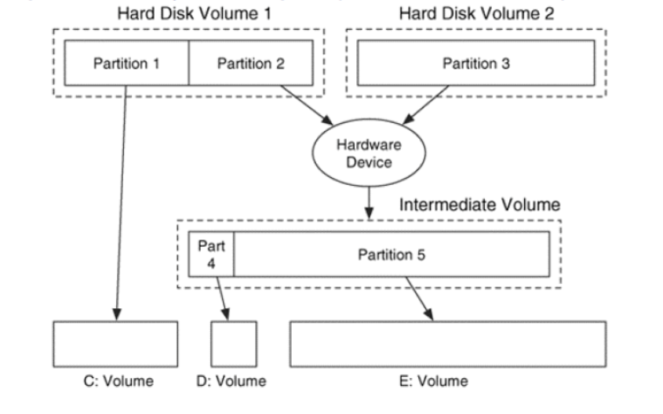
Volume Assembly
Larger systems use volume assembly techniques to make multiple disks look like one.
Notes:
Increase the disk capacity
No impact on the current data

Slide 9
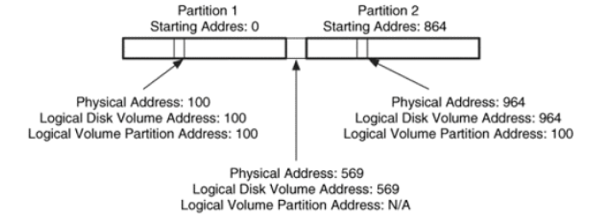
Sector Addressing
Volume is a collection of sectors.
Logical Volume Address
Notes:
We need to assign address to these sectors.
Logical volume address – sector
Starting and ending positions of partitions described using logical volume address. Since disk is a volume and volume is a sector. Disk address physical address.
logical partition volume address is relative to the start of the partition while the
logical disk volume address is relative to the start of the disk.

Slide 10
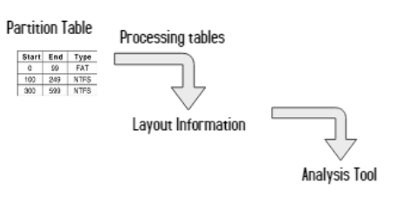
Analysis Basics
Notes:
In some cases extract data between partitions

Slide 11
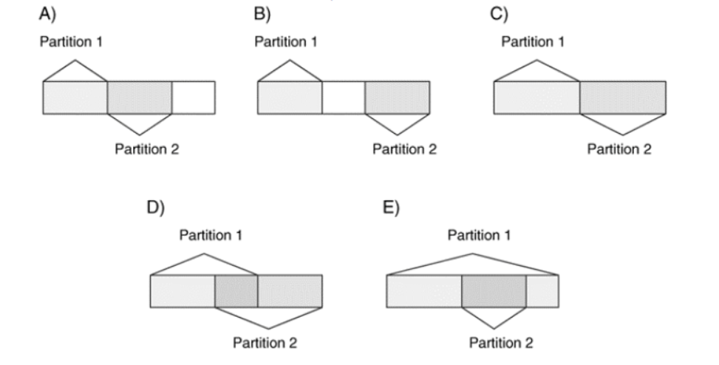
Consistency Checks
Important to analyze partitions relative to other partitions.
Notes:
When analyzing volume systems, it can be useful to check each partition relative to the other partitions.
It can be like a sanity check.

Slide 12
Extracting Partition Contents
Some tools take partition image as input or we might require certain data from a partition.
dd tool – for extracting partitions.
Command line based.
Commands:
if: The disk image to read from
of: The output file to save to
bs: The size of the block to read each time, 512 bytes is the default
skip: The number of blocks to skip before reading
count: The number of blocks to copy from the input to the output

Slide 13
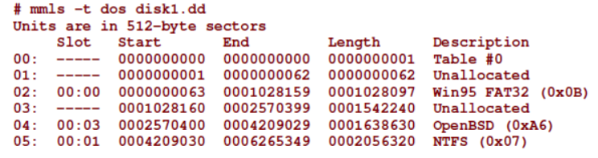
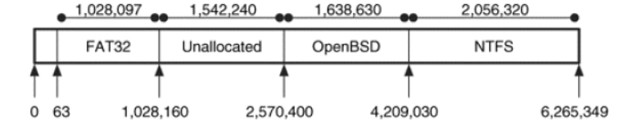
Example of DOS based partition system
mmls tool to list partition table.
Notes:
Mmls tool organizes the table content
Graphical representation of table.

Slide 14

Other low level tools like hex editors can be used to save sequential sectors to a file.

Slide 15
Recovering Deleted Partitions
Bad people clears the partition structures or data.
Recovering corrupt partitions.
Recovery tools work by assuming that a file system was located in each partition.
Example:
FAT has values 510 and 511 in first sector and cluster are formed in the power of 2.
Search mechanism varies.
Linux tool – gpart
Notes:
Original data is lost.
Analysis becomes much more difficult in these case
Fortunately there are tools to recover the partitions
For example, a FAT file system has the values 0x55 and 0xAA in bytes 510
and 511 of the first sector. The partition recovery tools search for these signature values and
identify where a partition may have started.
When the search tool finds a signature, additional tests can be conducted on the range of
values that are valid for a given data structure. For example, a FAT file system has a field that
identifies how many sectors are in a cluster, and it must have a value that is a power of 2,
such as 1, 2, 4, 8, 16, 32, 64, or 128. Any other value would indicate that the sector was not
part of a FAT file system boot sector, even though it ended with 0x55AA.
The searching mechanism of each tool may vary. Some tools examine each sector and
compare it to known signatures. Other tools search only cylinder boundaries because
partitions are typically created on cylinder boundaries. Others may use data from the file
system data structures to learn how big the file system is and jump to the end before
searching for more known data structures.

Slide 16
Summary
All large media devices have some type of volume system and it is analyzed in every investigation.
The volume systems exist to provide partitions or compartments in the media and the partition systems describe where each partition begins and where it ends.
This chapter has given the overview of the technology, and we will next explore the details of several partition and volume creation systems.

